Slide 1

Literature Review On Detection Of Pneumonia From Chest X-ray Images Using Convolution Neural Networks (CNNs)
JhansiRani Choutapalem
Registration No:2004458

Slide 2
Purpose
The purpose of this literature review is to overview the current literature available to detect and classify pneumonia using CNNs and transfer learning from chest X-ray images and to identify the limitations of techniques used in previous studies and provides suggestions for future work in this domain.

Slide 3
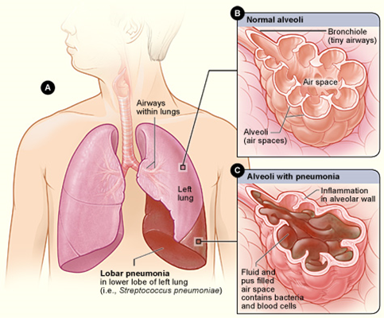
What is pneumonia?
Pneumonia is an acute respiratory infection, that causes inflammation of lung tissues.
The lungs are made up of small sacs called alveoli. In the person infected with pneumonia, these sacs gets filled with pus and fluid, which reduces the oxygen intake and breathing becomes painful.
Pneumonia is transmitted from a diseased individual to a healthy person through air-borne droplets from cough or sneeze.
Symptoms include difficulty in breathing, fever and wheezing is common in viral pneumonia
Figure1: Image showing part of left lung affected by pneumonia. Adapted from “https://www.nhlbi.nih.gov/health-topics/pneumonia ”

Slide 4
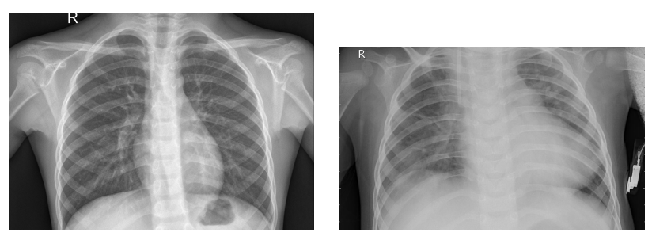
X-Rays for detecting pneumonia
X-rays are the most adopted method for diagnosing lung diseases as they are inexpensive and easily accessible.
The interpretation of chest X-ray as either normal or having any lung disease is decided after careful examination by an experienced radiologist.
X-rays are used as diagnosing tools as early as in 1930s.
Figure2: Normal chest X-ray(left) and chest X-ray of a person infected with bacterial pneumonia(right). Adapted from “https://www.kaggle.com/paultimothymooney/chest-xray-pneumonia”

Slide 5
Need for automation of X-Ray analysis using CNNs
Pneumonia is the greatest cause of death in children under the age of 5, accounting for more than 15% of all child deaths according to the World Health Organization.
In developing nations, a scarcity of competent radiologists is leading to alarmingly high child mortality rates.
Accurate and timely detection is vital in reducing the mortality in case of pneumonia.
Interpretation of chest X-Rays is often challenging even for experienced radiologists due to their lower resolution.
Automation of X-Ray analysis is essential to enhance the decision making and to fill the gap between the number of radiologists available and comparatively higher number of radiographs that need to be interpreted by each radiologist.
Using AI, Computer-Aided Diagnostic(CAD) systems can be developed which can sequentially extract and classify features from input data(chest X-ray), there by automating radiological image analysis, which is otherwise manual and time consuming.

Slide 6

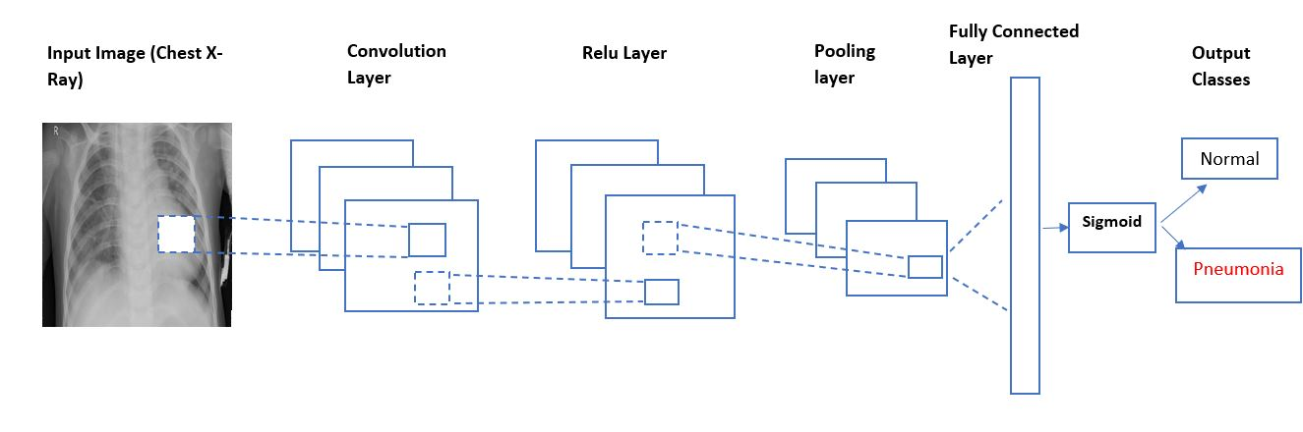
Convolution Neural Networks(CNNs)
The architecture of CNN is inspired by the visual cortex of human brain(Fukushima, 1987).
The typical architecture of a CNN contains one or more convolution layers, followed by pooling layers and one or more fully connected layers.
Figure3: Basic architecture of a CNN for classifying chest X-rays for detecting pneumonia

Slide 7

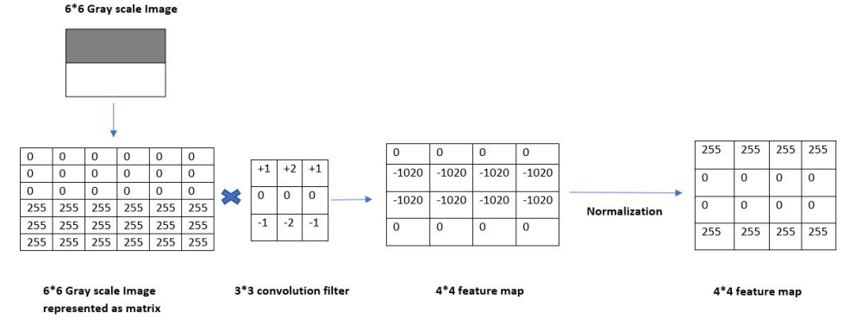
Convolution Layer
The convolution layer extracts different features from input tensor by convolving filters on input image, this process generate a feature map of processed image. This feature map is then fed as input to next layer.
The first convolution layer extracts low-level features such as lines and edges. Using more convolutions, the top-level layers extracts high-level features. The equation below shows the convolution of n × n size image with a kernel k × k producing a feature map of size (n − k + 1) × (n − k + 1).
Figure4: Convolution operation on 6*6 gray scale image

Slide 8

Padding and Strides in convolution
Padding is performed to generate output feature map that has same dimension as given input image. In padding we add a layer of zeros(zero padding) around the input matrix.
With input size 6 × 6, padding p = 1, n + 2p = 8. The output produced will be 6 × 6. The equation below showing padding operation:
The convolution operations start at the top-left corner of the input, filter is shifted from left to right till it reaches top right corner, then the filter shifts in downward direction until the bottom right corner is reached.
The shifting is decided by strides. Stride of one moves filter one element wise. Striding reduces the image size. The equation below shows stride operation, s denotes the stride size.

Slide 9

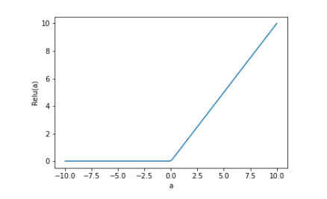
Relu
Relu(Rectified linear unit) is the most widely used non-linear activation function in CNN.
Relu removes negative values from feature map by setting their value zero. Relu is preferred over other activation functions such as sigmoid because sigmoid function suffers from vanishing gradient problem and convergence is also faster when Relu is used as activation.
Figure5: Pictorial representation of Relu activation function

Slide 10
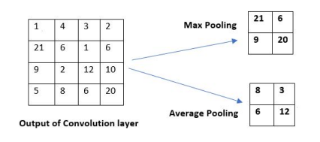
Pooling Layers
Pooling layer is also called sub sampling layer. Pooling helps to learn location, translation and scale invariant features.
Pooling greatly reduces the dimensions of the feature map. There are two main techniques of pooling: max pooling and average pooling.
Figure6: Pooling operation

Slide 11
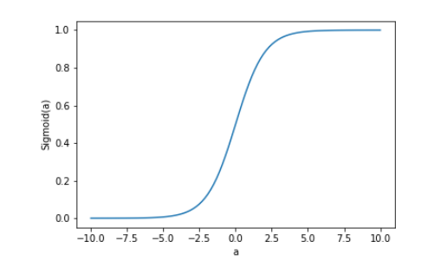
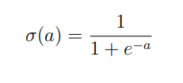
Fully Connected Layers, Classification layer
In fully connected layer every neuron in one layer is connected to every neuron in another layer. The final output after many convolutions and pooling are flattened and given to fully connected layer.
The output of fully connected layer is fed into classification layer which classifies the image into either as normal or having pneumonia. For binary classification, the sigmoid function is used in output layer.
Sigmoid outputs a probability, a value greater than 0.5 gives output 1(pneumonia) and value less than 0.5 outputs 0(indicating normal).
Figure5: Pictorial representation of sigmoid activation function

Slide 12
Design of Literature Review
Data Sources : The articles reviewed for the present work were mainly taken electronic databases.
IEEE Xplore
Google Scholar
Science Direct
Query terms : The following queries are formed to search databases to find the articles relevant for the present study
Pneumonia detection using CNN
Pneumonia detection OR classification of chest X-Rays using deep learning
Chest X-Ray OR chest chest radiographs classification using Convolution Neural Networks

Slide 13
Design of Literature Review
Based on the following inclusion and exclusion criteria the articles obtained were filtered for selection of relevant papers: :
Inclusion criteria:
Papers that performed studies relevant to pneumonia identification using chest radiographs.
Papers that were published after 2010 to early 2021.
Papers that were published in peer-reviewed journals or conferences were included.
Exclusion criteria:
Papers that were printed in languages other than English.
Research that is not related to pneumonia detection using chest radiographs.
Wikipedia, short reports, blogs, posters

Slide 14
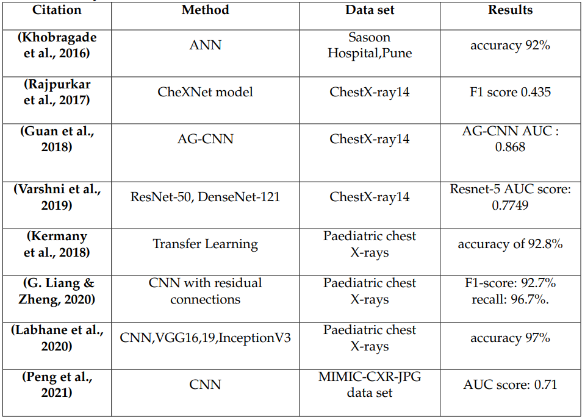
Table comparing various techniques used by researchers to detect pneumonia from chest x-rays

Slide 15
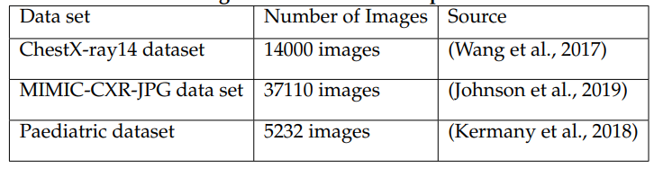
Table summarizing the data sets used for pneumonia detection

Slide 16
Conclusion
The use of CNNs and transfer learning to diagnose chest disorders, primarily pneumonia, was the focus of this report.
The work of previous researches showed promising results (Rajpurkar et al., 2017),(Guan et al., 2018), (Kermany et al., 2018),(Labhane et al., 2020), (Peng et al., 2021) to automate the need for X-ray diagnosis for pneumonia detection.
Inclusion of textual information such as patient’s medical history and clinical diagnosis is important to accurately diagnose a disease.
Constructing a model that can incorporate this information along with various other body indicators is more appropriate and easier for doctors to diagnose the lung diseases.
The models reviewed in this paper does not included this information. However, this information is important to determine the disease condition more accurately.
The models built in the future should include the patient's medical history and clinical symptoms to provide more accurate diagnosis of the condition present.

Slide 17

Thank you

